Slide 1
Mathematical Modeling of the Atmosphere – Overview and Examples of Two Current Issues
Donald Dabdub
Department of Mechanical & Aerospace Engineering
University of California, Irvine

Slide 2
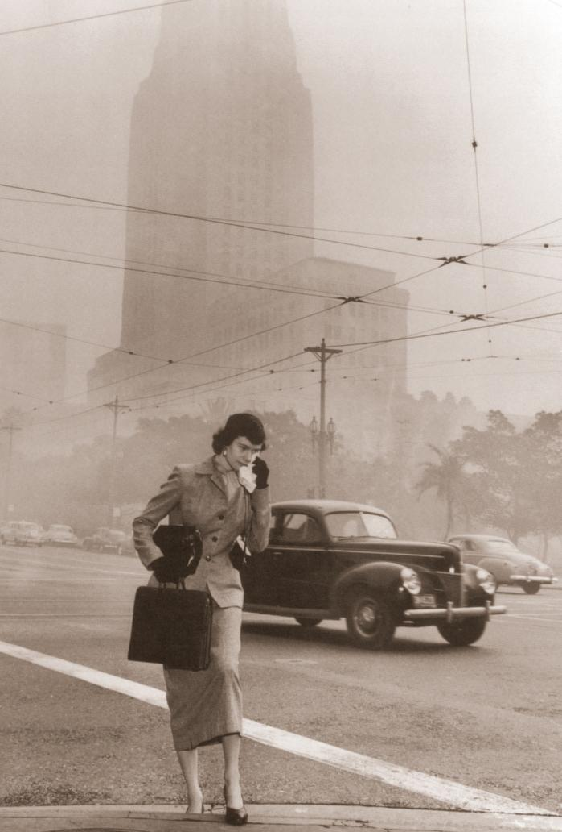

Slide 3

Satellite Observations
Atlantis over the Bahamas – International Space Station 7/10/2011
Photo courtesy of NASA’s Marshall Space Flight Center

Slide 4
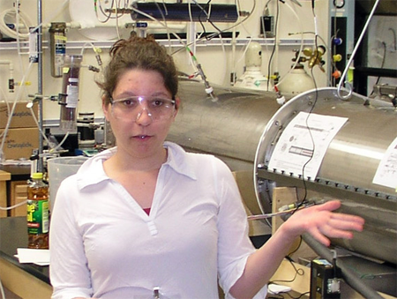
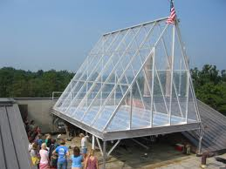
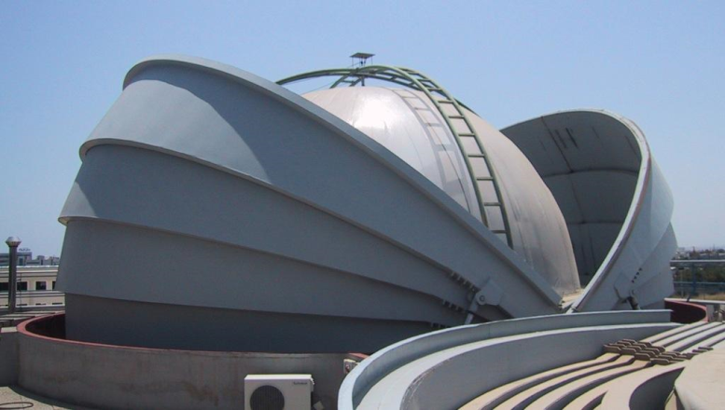
Chamber Studies
Aerosol Flow System
Indoor chamber
One Atmosphere Research
Outdoor chamber
EUPHORE
Outdoor smog chamber
UC Irvine
UNC
Valencia, Spain

Slide 5
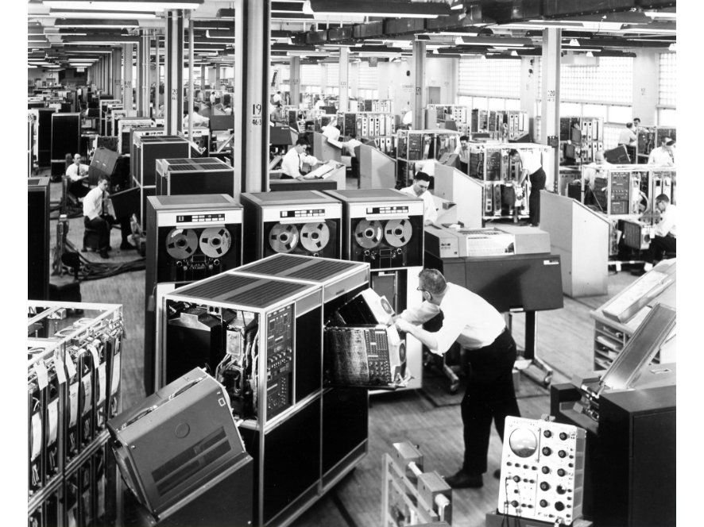
Computational Studies
IBM 1401 computer circa 1960
Photo courtesy of the IBM corporate archive

Slide 6
Different Types of Models
Numerical Weather Predictions Models
Climate Models
Chemical Atmospheric Models:
  Box Models
  Urban and Mesoscale Models
  Global Chemical Transport Models

Slide 7
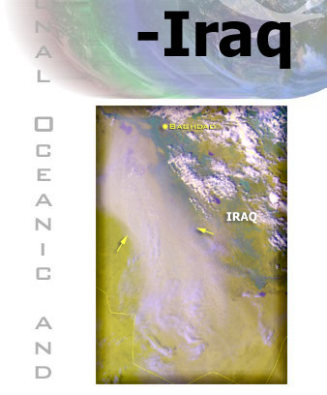
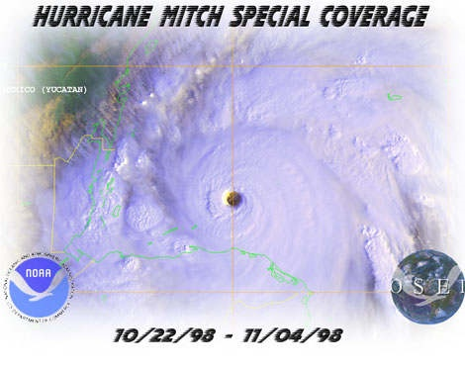
Numerical Weather Predictions

Slide 8
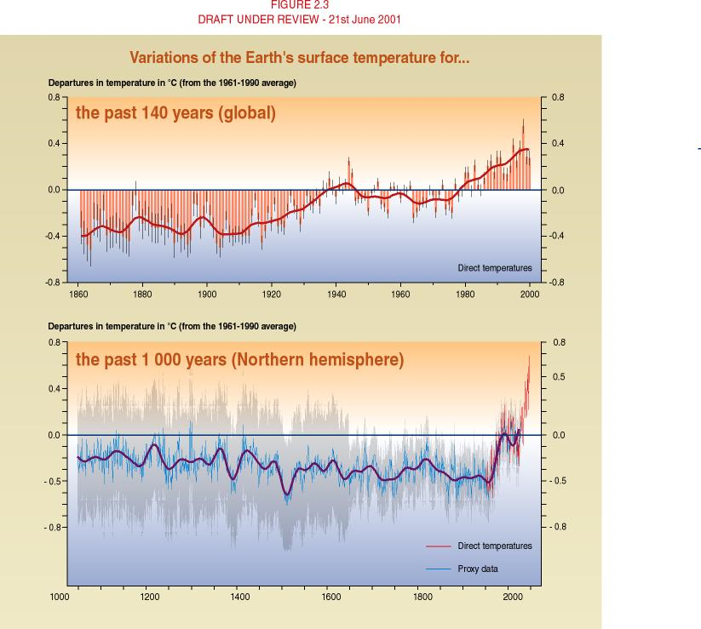
Global Climate Model

Slide 9
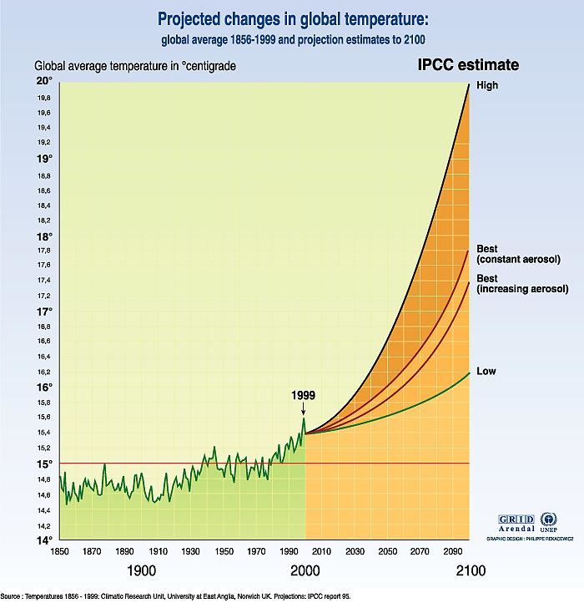
Global Climate Model

Slide 10
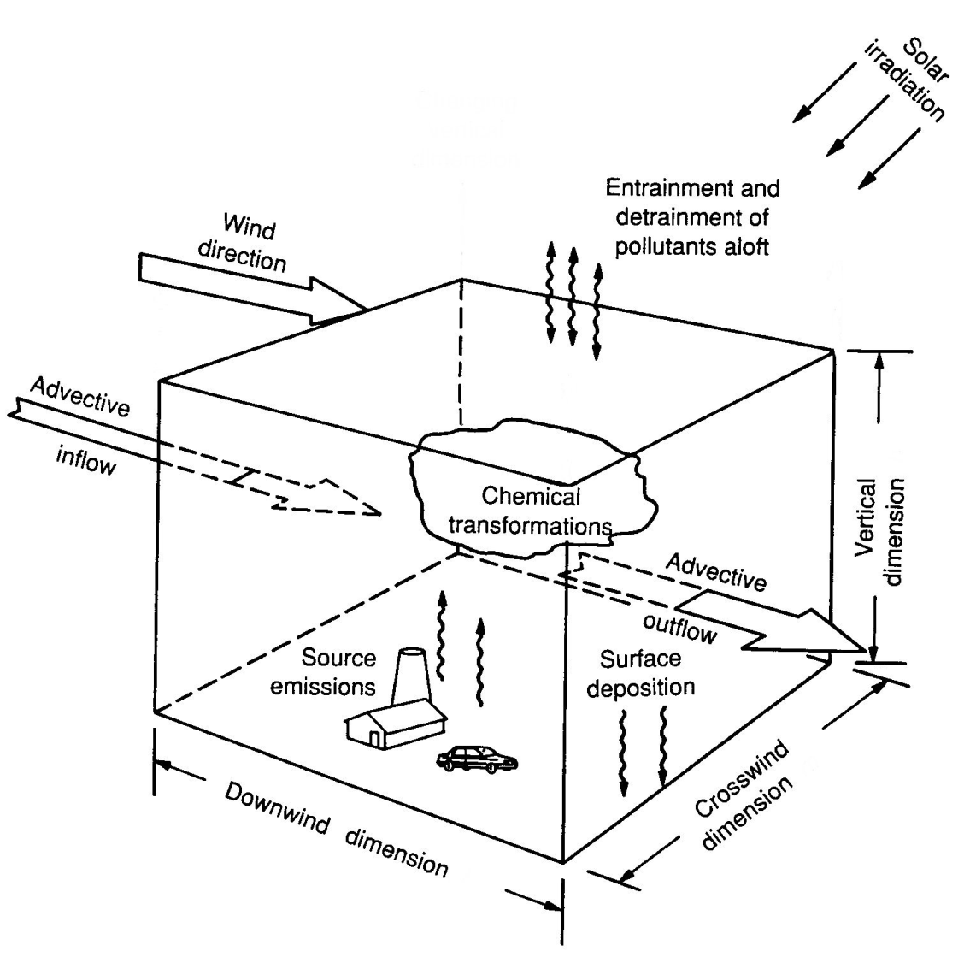
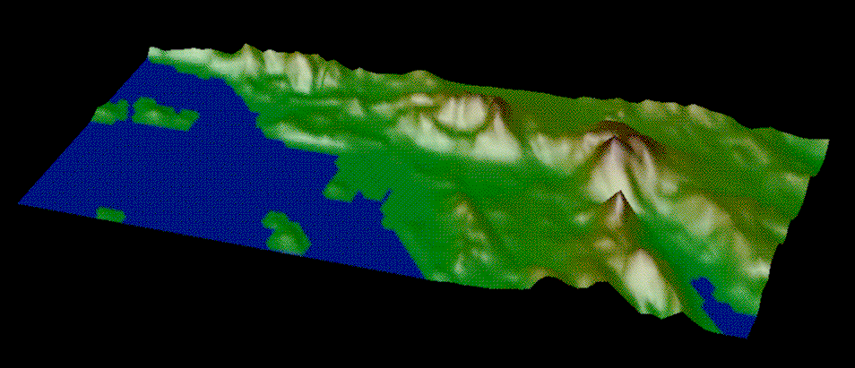
What is an Air Quality Model?
123 Gas Species
296 Aerosols: 37 species, 8 sizes
361 Reactions
1100 m
670 m
310 m
150 m
40 m
0 m
30
Cells
80 Cells
Each Cell: 5 x 5 km²

Slide 11

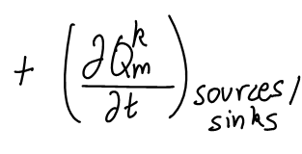

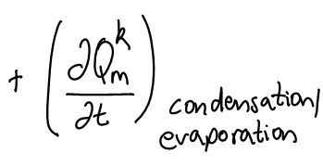
Mathematical Foundation
Source: Dabdub and Seinfeld, Parallel Computing, 22 (1995)

Slide 12
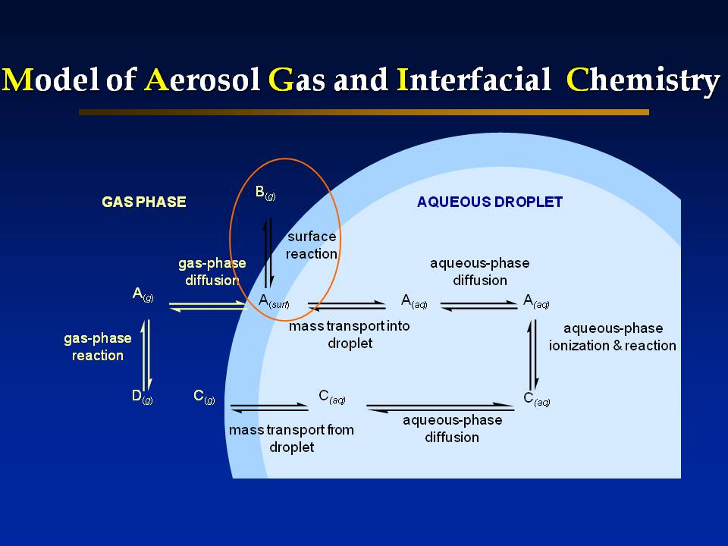
Modeling laboratory chambers
Source: Knipping et al., Science, 288 (2000)

Slide 13
Modeling the urban atmosphere
123 Gas Species
296 Aerosols: 37 species, 8 sizes
361 Reactions
1100 m
670 m
310 m
150 m
40 m
0 m
30
Cells
80 Cells
Each Cell: 5 x 5 km²
Source: Vutukuru and Dabdub, Atmospheric Environment, 42 (2008)

Slide 14
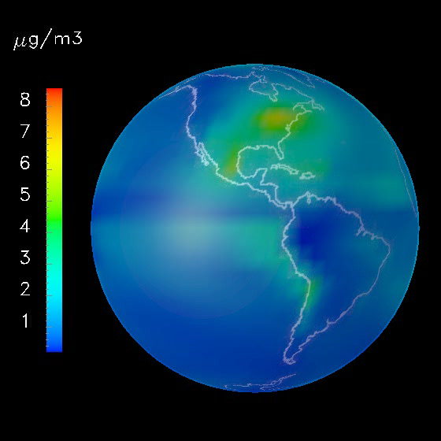
Global aerosol modeling
Sulfate
Source: Rodriguez and Dabdub, J. Geophys. Res., 109 (2004)

Slide 15
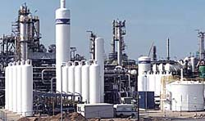
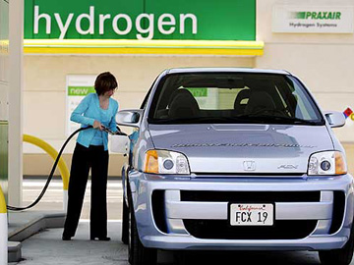
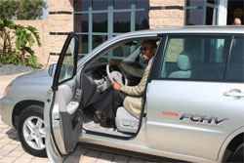
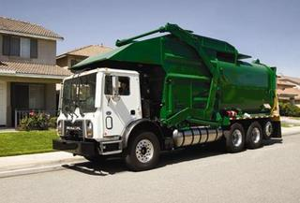
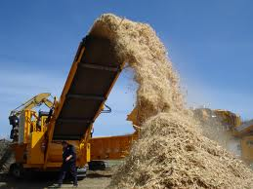

Applications Outline
Hydrogen Fuel Cell Vehicles
  Hydrogen production infrastructure
  Distribution and consumption of hydrogen
Use of Biomass for Biopower vs Biofuel
  Biomass infrastructure for biopower
  Shift from biopower to biofuel

Slide 16
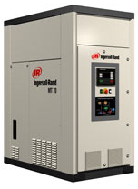
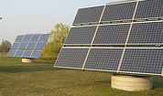
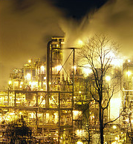
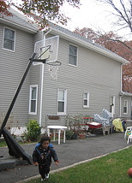


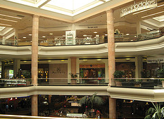
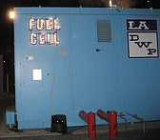
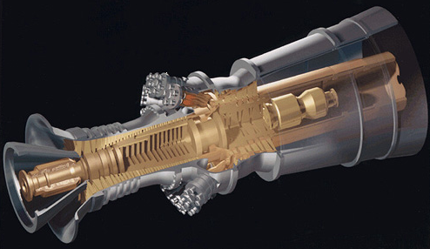
Central vs. Distributed Generation
Microturbine
Solar
Gas Turbine
Fuel Cell

Slide 17
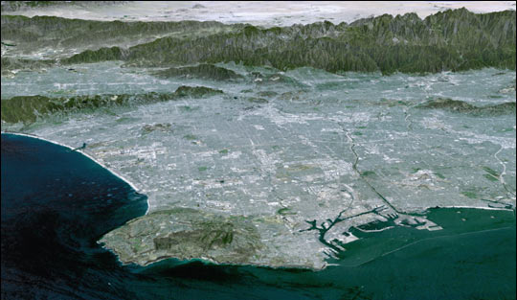
Project Overview
Infrastructure scenarios
3-D air quality model
Determine spatial/temporal
emissions
100+ Gas Species
20+ Aerosol Species
300+ Reactions
1100 m
670 m
310 m
150 m
40 m
0 m
80 Cells
Each Cell: 5 x 5 km²
Air quality impacts
?
?
Determine GHG
co-benefits
?
Determine
spatial/temporal
AQ impacts
Los Angeles
Riverside
?
?
Long Beach

Slide 18
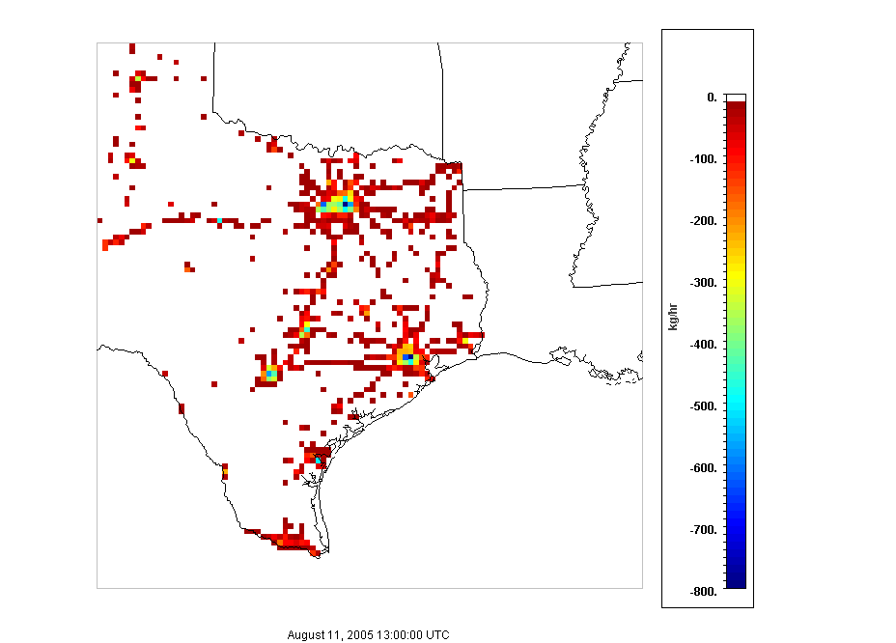
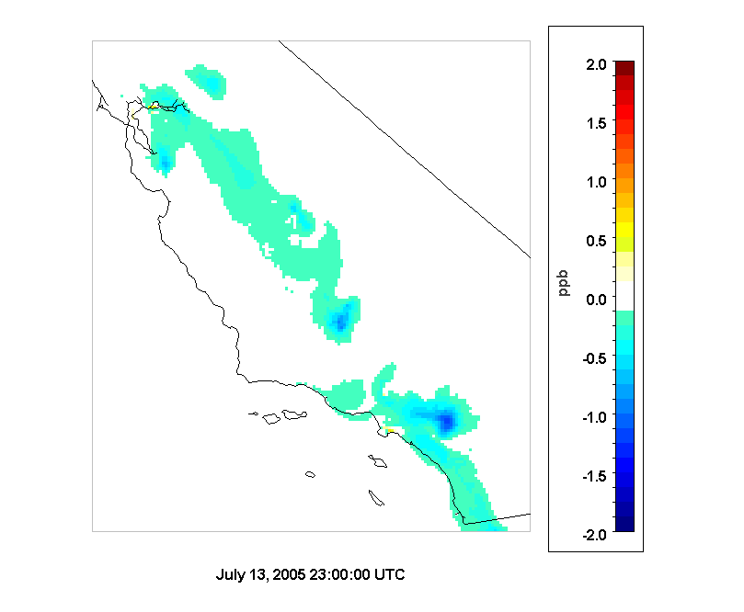
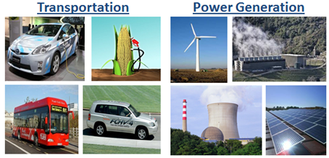
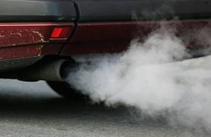
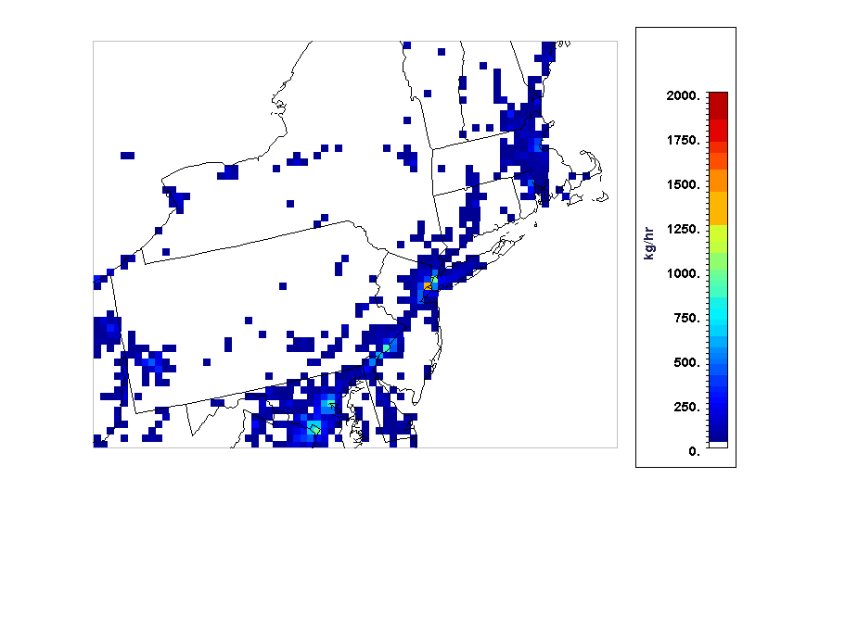
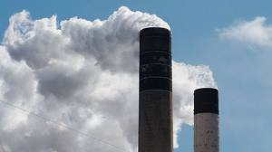
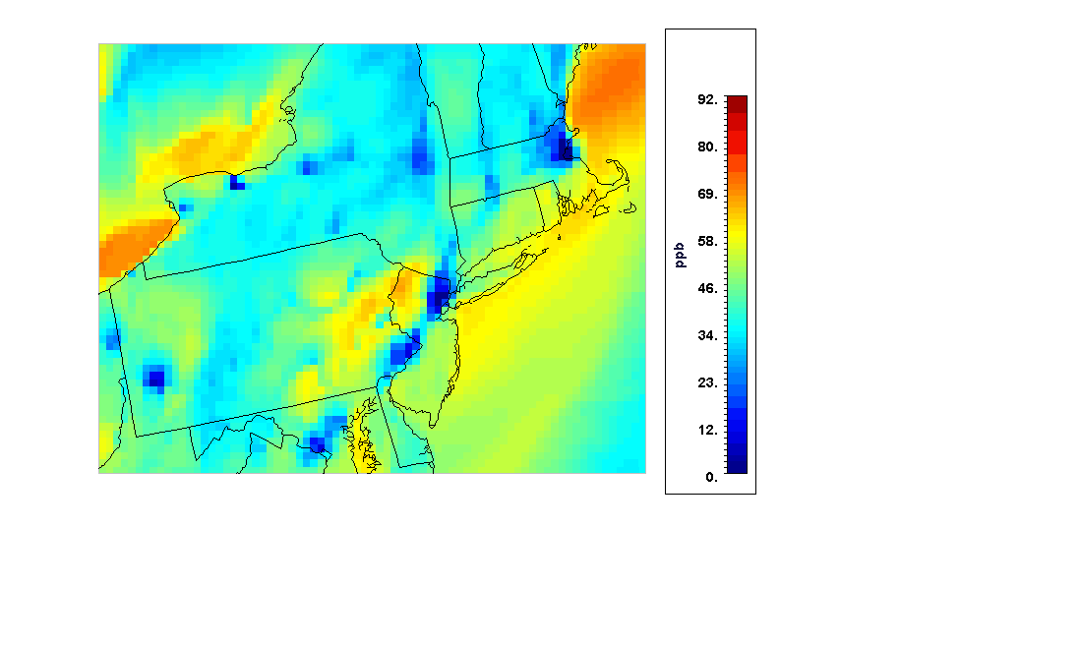
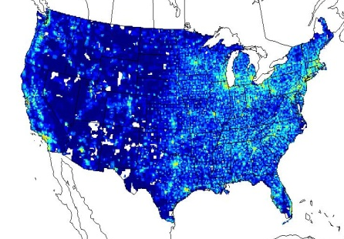

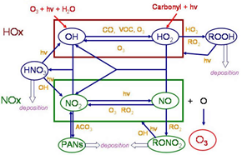
Methodology
Technology Scenarios
Pollutant Emissions
Air Quality Simulations
Sparse Matrix Operator Kernel Emissions (SMOKE) Model
Community Multi-scale Air Quality (CMAQ) Model
Dilution, transport and mixing Photochemical transformation
Baseline Emissions
2005 EPA NEI
Spatial Surrogates
Activity Profiles
Meteorological Fields
Chemical Mechanism
Emissions of NO_{x} over a 24 h period in 2005
Ozone concentration over a 24 h period in 2005

Slide 19
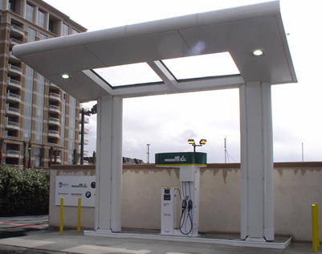
Hydrogen Fuel Cell Vehicles
What are the requirements for the implementation of FCV?
  Infrastructure for hydrogen production
  and distribution for fuel cell vehicles
  Hydrogen fuel cell vehicles adoption
How are emissions spatially
distributed?
What are the potential air quality
impacts?

Slide 20
Integrated Fuel Cycle Analysis - Hydrogen
Hydrogen
Generation
Hydrogen
Distribution
Hydrogen
Utilization
Input:
Total
Hydrogen
Distributed:
%
SMR
%
Compression
Vehicle Dispensing
Natural
Gas
%
Electrolysis –
Grid
%
Liquefaction
Vehicle Dispensing
Electricity –
Grid
Centralized:
%
Compression
Vehicle Dispensing
%
SMR
Pipeline
%
%
Liquefaction
Vehicle Dispensing
Electricity –
Renewable
%
Coal Gasification
%
Compression
Tube Trailer
%
Compression
Vehicle Dispensing
Water
%
Compression
Liquid Tanker
%
Compression
Vehicle Dispensing
%
Electrolysis –
Renewable
Coal
Input:
Input:
Input:
Adjust
Contribution
Adjust
Contribution
Output:
Adjust
Contribution
GHG emissions
Energy consumption
Criteria pollutant emissions
Water consumption
Notes:
At the heart of our assessment methodology is a model that analyzes the performance of an integrated hydrogen supply chain from a life cycle perspective. It includes the generation of hydrogen, hydrogen distribution, and hydrogen utilization.
As an input the model requires some quantity of hydrogen… In the trial cases that we ran, for example, the input was in kg per day of hydrogen based on projected demand in Southern California.
The remaining inputs are to adjust the contribution by each technology to the overall supply of hydrogen.
We have hydrogen generation including both centralized and distributed technologies and the adjusted contribution by each of these technologies also determines the feedstock resources required.
Where hydrogen generation is centralized, distribution is required,
AND regarding dispensing, a variety of pressures for gaseous dispensing are included as well as liquefied hydrogen.
Now this is a simplified schematic of the model. Currently it includes several additional technologies and is friendly to adding more for future studies.
The outputs include GHG emissions, energy consumption, criteria pollutant emissions, and water consumption. The model is adaptable in that more outputs could be included. It is also compatible with existing analysis tools such as the DOE’s H2A model that deals with cost.
I’m going to show you an example of the results, but to do that I’ll first establish a case for the adoption of hydrogen infrastructure.

Slide 21
Year: 2060 | Scenario-R: |  |  |  |  | Scenario-F:
 | H₂ generated from more renewable sources |  |  |  |  | H₂ generated from more fossil fuel sources
Population of HFCV | 10,162,500 |  |  |  |  | 10,162,500
Hydrogen demand (kg/day) | 5,943,730 |  |  |  |  | 5,943,730
VMT/day by HFCV | 573,807,694 |  |  |  |  | 573,807,694
Hydrogen Generation | Number of facilities | H₂ output (kg/day) | Percent contribution | Location relative to the SoCAB |  | Number of facilities | H₂ output (kg/day) | Percent contribution | Location relative to the SoCAB
Centralized
Steam Methane Reforming | 15 | 2,022,285 | 34.0% | Inside |  | 16 | 2,157,104 | 36.3% | Inside
Coal IGCC | 5 | 641,560 | 10.8% | Outside |  | 12 | 1,539,744 | 25.9% | Outside
Petroleum Coke IGCC | 0 | 0 | 0.0% | Inside |  | 2 | 247,466 | 4.2% | Inside
Electrolysis | 7 | 1,905,133 | 32.1% | Outside |  | 7 | 429,196 | 7.2% | Outside
Distributed
Steam Methane Reforming | 155 | 135,700 | 2.3% | Inside |  | 155 | 135,700 | 2.3% | Inside
Stationary Fuel Cell | 2,023 | 736,372 | 12.4% | Inside |  | 2,560 | 931,840 | 15.7% | Inside
Electrolysis | 950 | 305,942 | 5.1% | Inside |  | 950 | 305,942 | 5.1% | Inside
Home or Office Fueling | 39,348 | 196,738 | 3.3% | Inside |  | 39,348 | 196,738 | 3.3% | Inside
Hydrogen Distribution | Distance (km/kg H₂) | H₂ throughput (kg/day) |  |  |  | Distance (km/kg H₂) | H₂ throughput (kg/day)
Remote pipelines | 50 | 2,546,693 |  |  |  | 50 | 1,968,940
Urban pipelines | 15 | 3,064,615 |  |  |  | 15 | 3,064,615
Liquid tanker | 30 | 1,504,363 |  |  |  | 30 | 1,308,895
Hydrogen Refueling |  | H₂ delivered (kg/day) | Percent contribution |  |  |  | H₂ delivered (kg/day) | Percent contribution
140 bar gaseous fueling |  | 4,108,125 | 70% |  |  |  | 4,108,125 | 70%
350 bar gaseous fueling |  | 1,760,625 | 30% |  |  |  | 1,760,625 | 30%

Slide 22
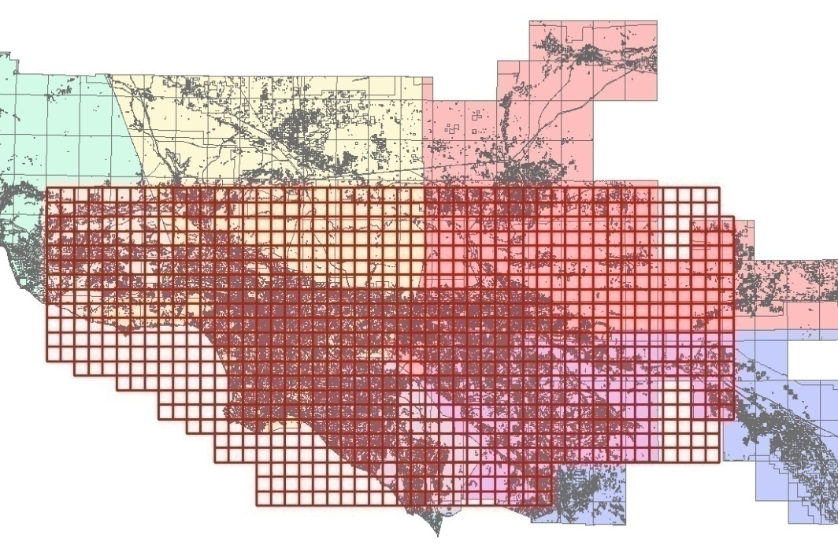
GIS Data
Central Los Angeles
Source: Southern California Association of Governments
Notes:
22

Slide 23
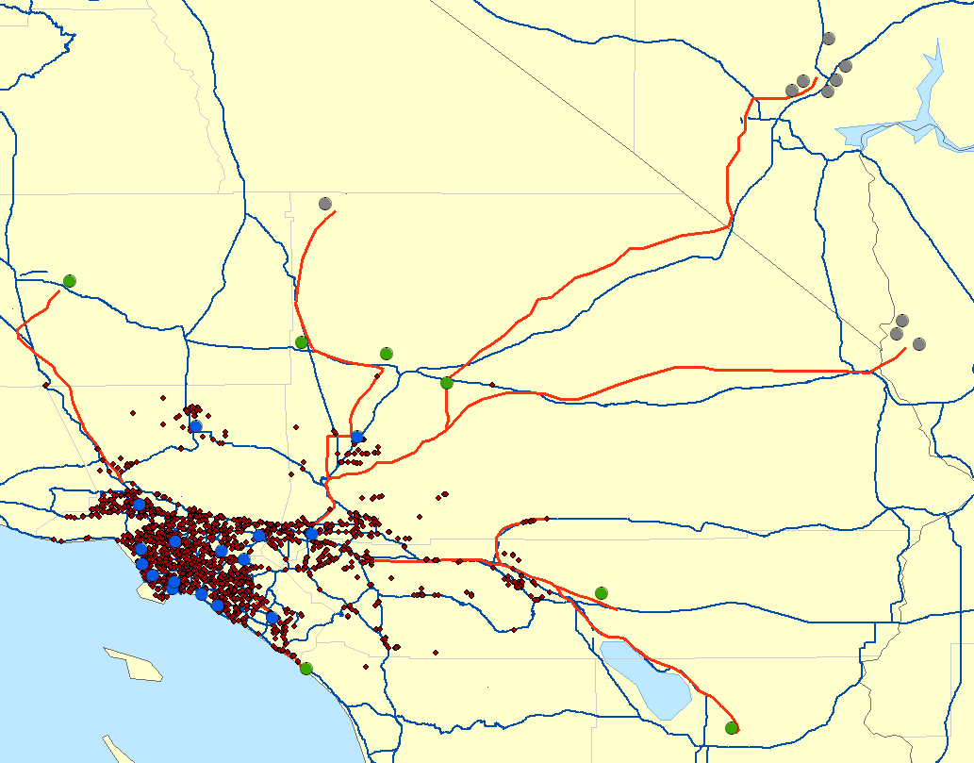
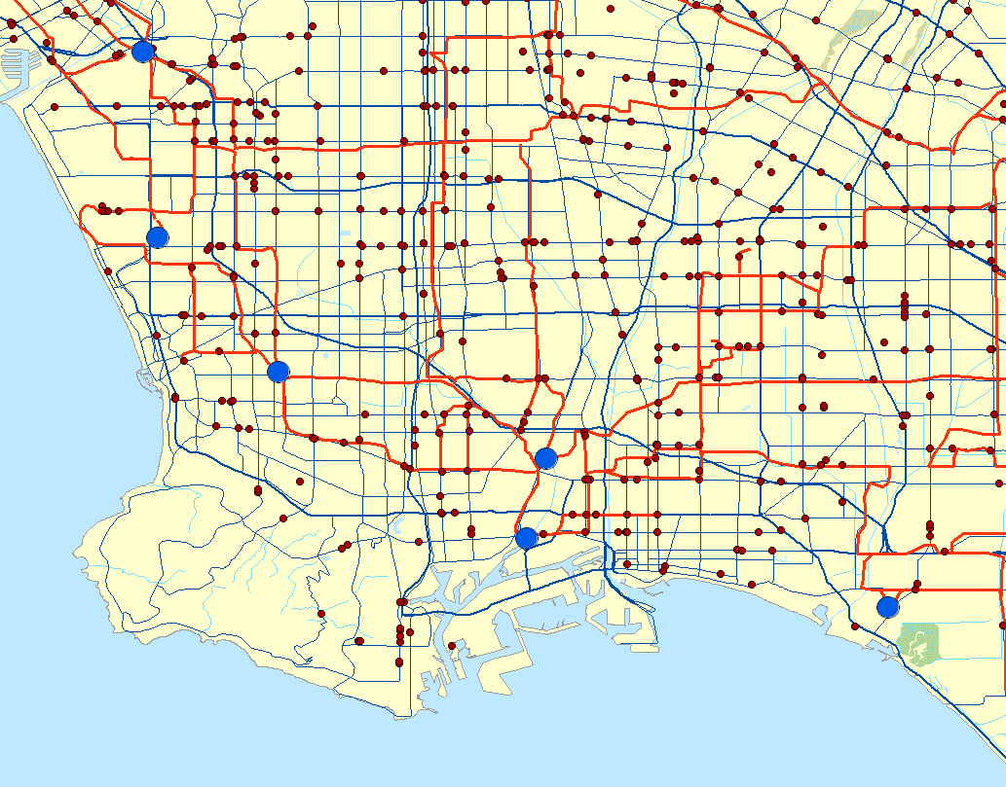
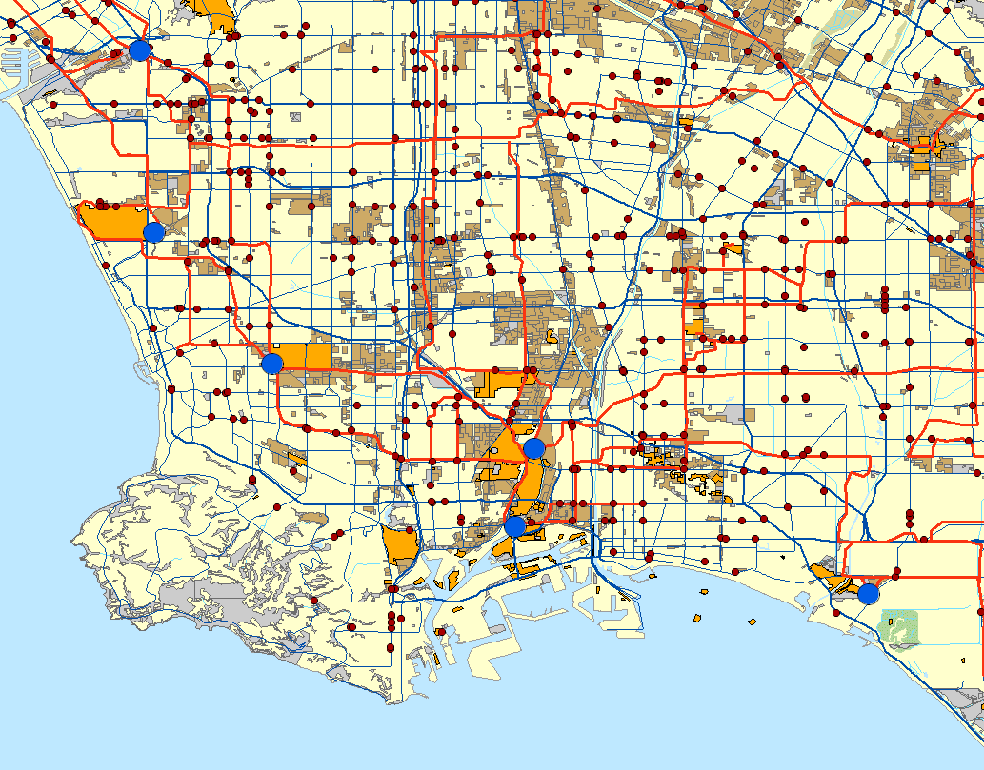
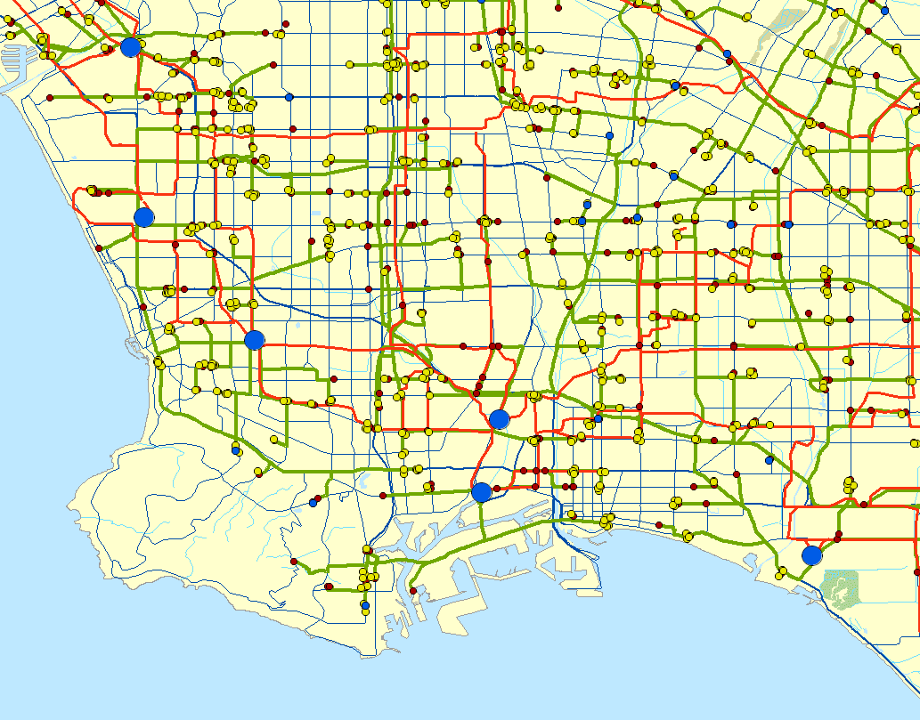
Spatial & Temporal Distribution
Southern California
Year: 2050
NV
H₂ Fueling Stations
Regional SMR
Regional Petroleum Coke
Central Coal/Biomass
Central Renewable /Nuclear
Local High-Temp Fuel Cells
Distributed SMR
Interstates & Freeways
H₂ Pipelines
H₂ Truck Deliver Routes
Land Use
Industrial
Vacant
Oil & Gas Infrastructure
CA
AZ
Truck Delivery Routes
Distributed Generation
Los Angeles

Slide 24
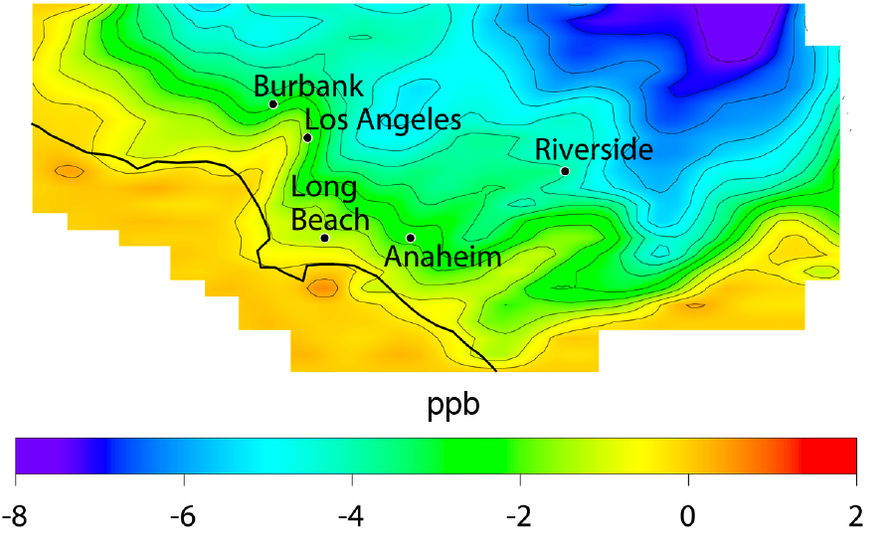
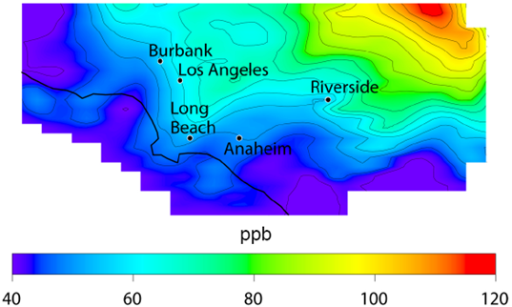
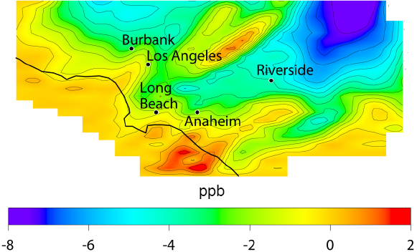
Results: Ozone
FCV with More Renewable-based H₂
Ozone: 8-hour average
[Δ Scenario vs. Baseline]
Baseline
FCV with More Fossil Fuel-based H₂
Notes:
The difference in the two scenarios is in how the hydrogen is produced. See table in the back-up slides. In summary, in the “more renewables” case there is a higher percentage of H2 produced by electrolysis using renewables outside the basin, with respect to the “more fossil fuel” case. In the “more fossil fuel” case, there is a high percentage of H2 produced by gassification of coal, which occurs outside the basin, and gassification of petroleum coke (petcoke), which occurs inside the basin. Petcoke is a by-product of petrochemical processing. It can be used in aluminum and steel industry, or it can be processed to produce fuels. There are large reserves in the Long Beach/Los Angeles petrochemical hub. In terms of air quality, the differences in air quality impacts between the two cases are due to the emissions from H2 production from petcoke. Two plumes downwind from Long Beach can be spotted in the “more fossil fuel” case plot.

Slide 25
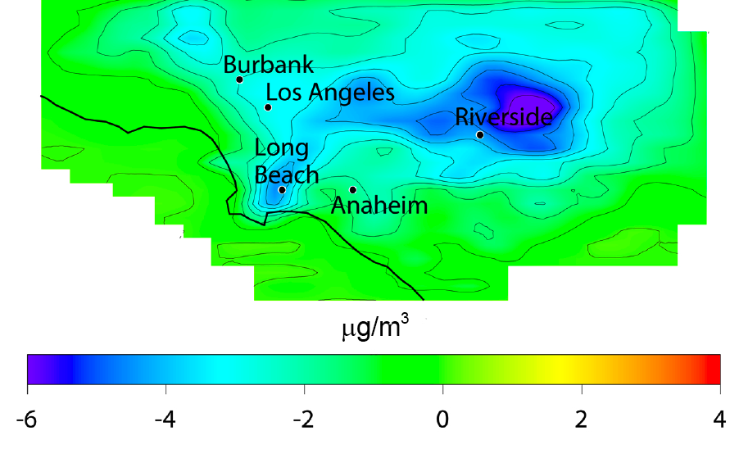
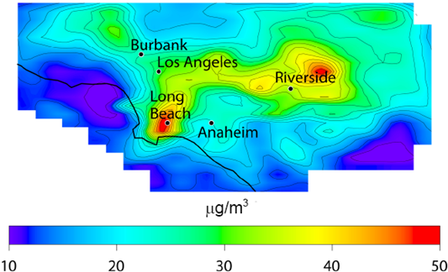
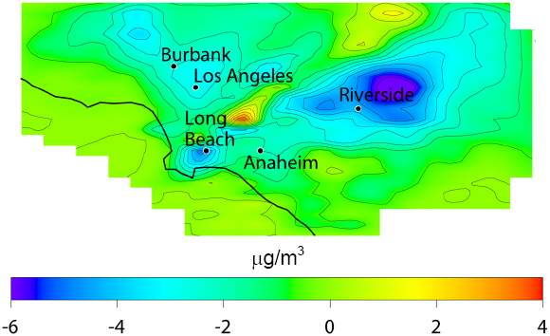
Results: PM_{2.5}
FCV with More Renewable-based H₂
PM_{2.5}: 24-hour average
[Δ Scenario vs. Baseline]
Baseline
FCV with More Fossil Fuel-based H₂
Notes:
As explained in the previous slide, the differences in air quality impacts between the two cases are due to the emissions from H2 production from petcoke. There is a spike in PM2.5 emanating from Long Beach that travels northeast in the “more fossil fuel” case plot.

Slide 26
Use of Biomass for Biopower vs Biofuel
What are the biomass resources?
  Types of biomass available
  Co-location of biomass installations
  with power and fuel infrastructure
How are biomass resources used?
  Biopower production
  Biofuel production: bio CNG, Ethanol
What are the potential air quality
and greenhouse gas impacts?

Slide 27
Overview of California Biomass Resources
California great biomass
resources (CBC, 2011):
  Biopower current capacity: 1200 MW
  Potential additional capacity: > 4,000 MW
Tittmann et al. 2008

Slide 28
Existing vs Technical Potential
Solid Fuel Technical Potential (MWe)
Source: California Biomass Collaborative, 2011

Slide 29
Emission Factors
Average CA solid fuel facilities
ARB BACT for biogas engines
1·10⁻²
2008 ARB limits for DG
2013 ARB
limits for DG
Biogas from wastewater treatment plants,
landfill gas, and animal manure
Forest and other solid fuels

Slide 30
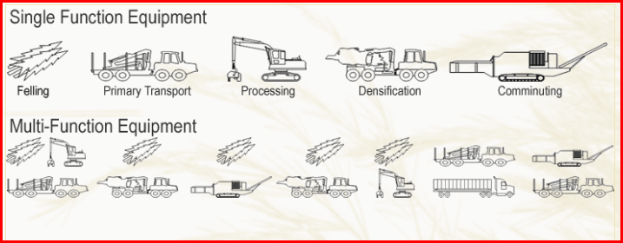



Collection and Transport
Include collection and transportation emissions

Slide 31

Analysis of Full Cycle Emissions
Following ARB’s Low Carbon Fuel Standards Pathways
Using CA-GREET model emissions for well-to-tank processes

Slide 32
Potential Emissions from Biomass Use

Slide 33


Spatial Allocation of Emissions
2020 Technical Potential: NO_{X} Emissions
Facilities
Collection and Transport

Slide 34


Effect of Maximum Biopower Potential
Maximum Biopower vs Current Biopower
Difference in Max 1-hour Ozone
Difference in 24-hour average PM_{2.5}
Notes:
Note that this scenario assumes 4 GW of new biopower installed in California, and that central generation is reduced by the same amount. In other words, this scenario assumes a reduction in emissions from central power plants that correspond to 4 GW of power. Considering that there is 60 GW of central generation in the state, the emission reductions from central power generation correspond to a reduction of 6.7% in emissions from power generation. This reduction is only a small fraction of the total emissions from biopower that are introduced in the state. Hence, the negative impacts on emissions and air quality of this particular scenario.

Slide 35


Effect of CNG vehicles
Maximum CNG vs Current Biomass
Difference in Max 1-hour Ozone
Difference in 24-hour average PM_{2.5}
Notes:
Note that this compares current biopower case vs. a case with all technical biomass resources used to produced CNG. CNG from biogas is simply produced by cleaning up the biogas and compressing it. CNG from solid biomass is produced by gasification of biomass, followed by methanation, and gas clean-up.
So the Max CNG case removes current biopower installations, resulting in decrease in emissions and decreases in ozone and PM2.5 in the great parts of the state.
Gasification produces mostly CO, H2, CO2 and H2O. Then the flue gas goes through methanation, which converts H2 and CO into methane:
CO + 3 H2 → CH4 + H2O
This is the reverse reaction of steam methane reformation.

Slide 36
Two-thirds to three-quarters reduction in NOx needed to attain ozone standards
Nitrogen Oxides Emissions in 2023
with Adopted Standards
Additional Needed Emission Reductions
* Source: Ambient ozone modeling conducted by SCAQMD, 2012; final data

Slide 37
Goods Movement Contribution

Slide 38

Capabilities
Air Emissions and Air Quality Modeling Tools:
  Systematic and highly resolved
  methodology to analyze alternative
  fuels:
    Hydrogen
    Biofuels
    Distributed electricity
  Analysis of criteria pollutants and
  greenhouse gases emissions
  Potential uses for toxics

Slide 39

Thanks!

Slide 40
References
Rodriguez M., Carreras-Sospedra M., Medrano M., Brouwer J., Samuelsen G.S. and Dabdub D., 2006. Air quality impacts of distributed power generation in the South Coast Air Basin of California 1: scenario development and modeling analysis. Atmospheric Environment, 40, 5508-5521.
Carreras-Sospedra M., Dabdub D., Brouwer J., Knipping E., Kumar N., Darrow K., Hampson A. and Hedman B., 2008. Air quality impacts of distributed energy resources implemented in the North-eastern United States. Journal of the Air & Waste Management Association, 58, 902-912.
Medrano, M., Brouwer, J., Carreras-Sospedra, M., Rodriguez, M.A., Dabdub, D., Samuelsen G.S., 2008. A Methodology for Developing Distributed Generation Scenarios in Urban Areas using Geographical Information Systems. International Journal of Energy Technology and Policy, 6, 413-434.
Carreras-Sospedra M., Vutukuru S.K., Brouwer J., Dabdub D., 2010. Air Quality Impacts of Central Power Generation Compared to Distributed Generation in the South Coast Air Basin of California. Atmospheric Environment, 44, 3215-3223.
Vutukuru S., Carreras-Sospedra M., Brouwer J. and Dabdub D., 2011. Future impacts of distributed power generation on ambient ozone and particulate matter concentrations in the San Joaquin Valley of California.. J. Air & Waste Manage. Assoc., 61, 1319-1333
Stephens-Romero S.D., Samuelsen G.S., 2008. Demonstration of a novel assessment methodology for hydrogen infrastructure deployment . International Journal of Hydrogen Energy. 34, 628-641.
Stephens-Romero S.D., Carreras-Sospedra M., Dabdub D., Brouwer J., Samuelsen G.S., 2009. Determining Air Quality Impacts of Hydrogen Infrastructure and Fuel Cell Vehicles. Environmental Science Technology. 43, 9022-9029.
Stephens-Romero S.D., Brown T.M., Kang J.E., Recker W.W., Samuelsen G.S., 2010. Systematic planning to optimize investments in hydrogen infrastructure deployment. International Journal of Hydrogen Energy, 35, 4652-4667.

